Slide 1

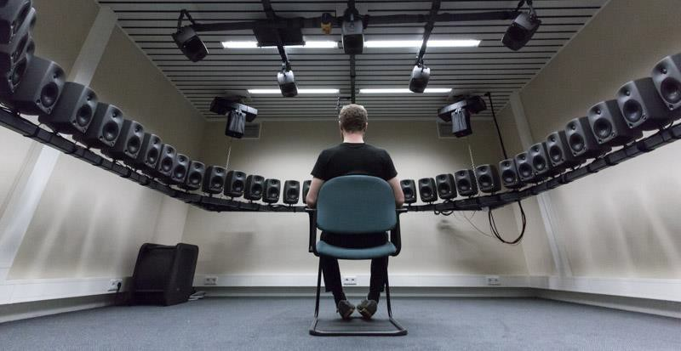
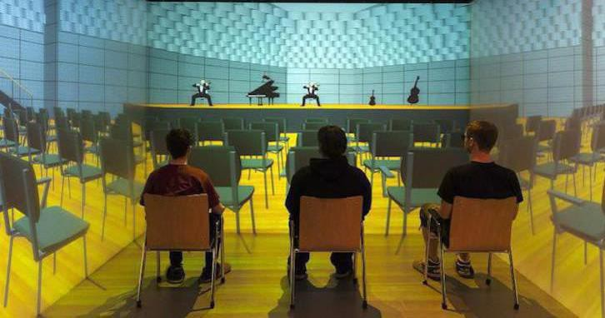
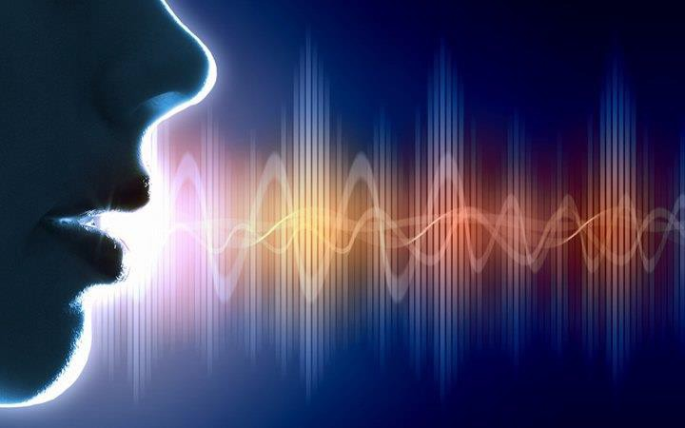
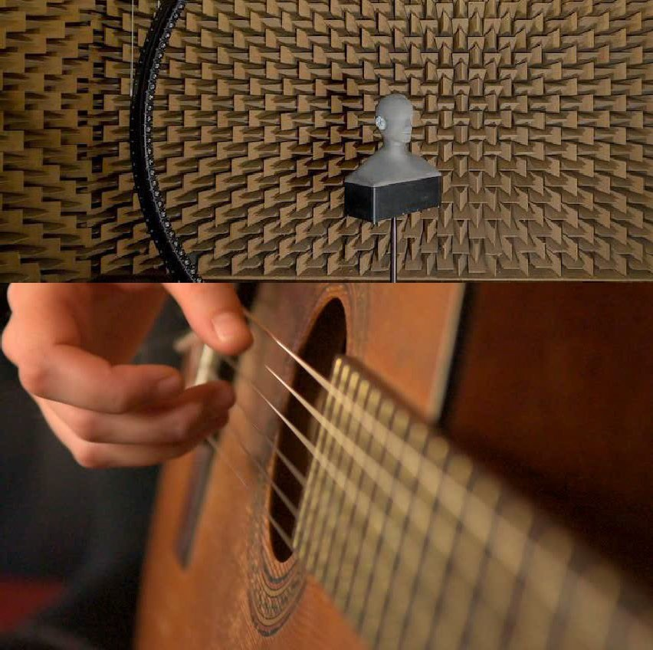
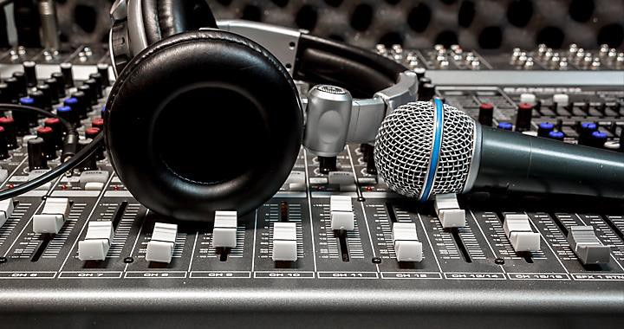
The Science of Sound
Module 1 – Physics of Sound
Tanmayee Pathre (t.u.pathre@tue.nl)
lectures adapted from the textbook Building Acoustics Group
Pictures from Google

Slide 2
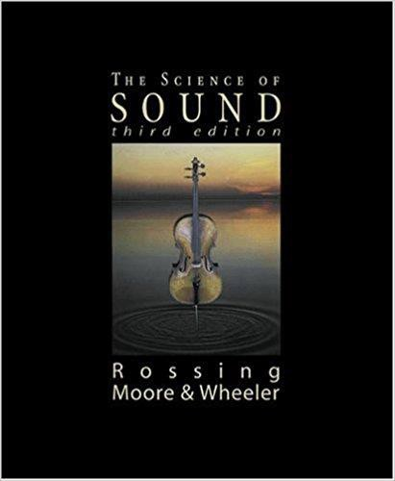
Contents
Fundamentals of sound
What is sound
Sound source
Physical quantities
Vibrating systems
Mass-spring system
Simple harmonic motion
Waves
Properties
Progressive Waves, Impulsive waves
Wave phenomena
Resonance
Definition
Standing wave in pipes and string
Acoustic Impedance

Slide 3

Learning Objectives
Understand the concept of wave and the relationship between wave speed, wavelength and frequency
Understand the concept of harmonic motion and resonance frequency of a spring-mass-damper system
Understand the principles of sound reflection, refraction, diffraction, interference and Doppler effect
Be able to perform basic calculations regarding quantities such as resonance frequencies, acoustic impedance or acoustic energy
Be able to perform basic calculations regarding the design of acoustic resonators

Slide 4
Fundamentals of sound

Slide 5
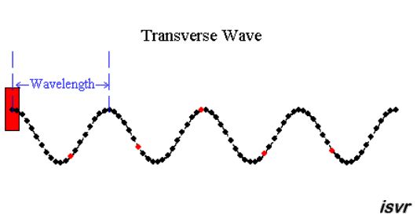
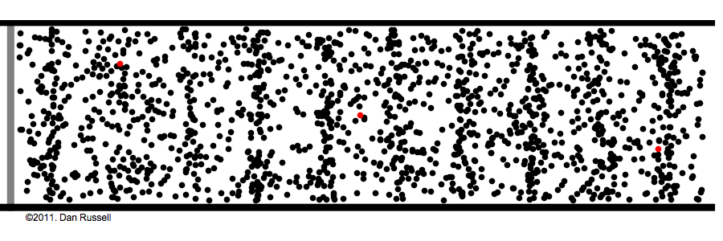
Fundamentals of Sound
What is sound?
An auditory sensation in the ear
The disturbance in a medium that can cause this sensation
Sound wave
Longitudinal wave
(NOT) Transverse wave
Longitudinal wave
Transverse wave
ISVR – University of Southampton http://resource.isvr.soton.ac.uk/spcg/tutorial/tutorial/Tutorial_files/Web-basics-nature.htm

Slide 6
Fundamentals of Sound
Sound source
Vibrating bodies – Striking drum kit
Changing airflow – Talking or singing
Time-dependent heat sources – Explosion
Supersonic flow – Shock wave
https://www.youtube.com/watch?v=ycRVAcZC5R4

Slide 7

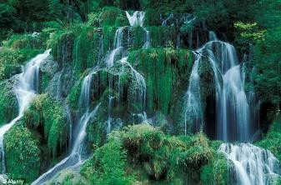
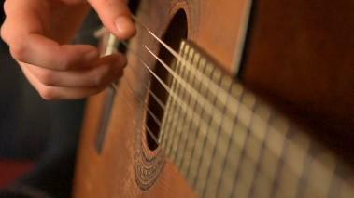

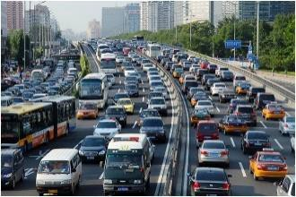
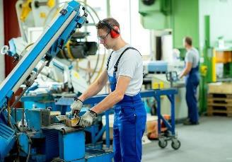
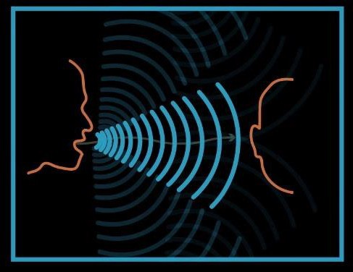
Fundamentals of Sound
Sound source
Unwanted
“Noise”
Wanted
Sound source
Medium
Listener

Slide 8
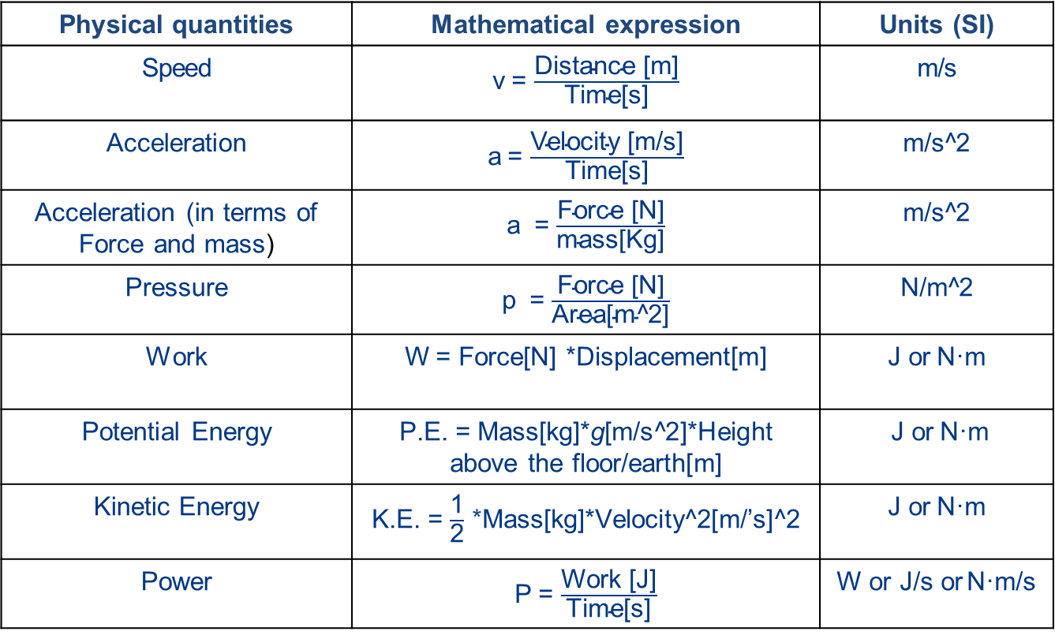
Fundamentals of Sound
Physical quantities
Physical quantities | Mathematical expression | Units (SI)
Speed | v = $\frac{\text{Distance}\text{ [}\text{m}\text{]}}{\text{Time}\text{[}\text{s}\text{]}}$ | m/s
Acceleration | a = $\frac{\text{Velocity}\text{ [}\text{m}\text{/}\text{s}\text{]}}{\text{Time}\text{[}\text{s}\text{]}}$ | m/s^2
Acceleration (in terms of Force and mass) | a = $\frac{\text{Force}\text{ [}\text{N}\text{]}}{\text{mass}\text{[}\text{Kg}\text{]}}$ | m/s^2
Pressure | p = $\frac{\text{Force}\text{ [}\text{N}\text{]}}{\text{Area}\text{[}\text{m}\text{^}\text{2}\text{]}}$ | N/m^2
Work | W = Force[N] *Displacement[m] | J or N·m
Potential Energy | P.E. = Mass[kg]*g[m/s^2]*Height above the floor/earth[m] | J or N·m
Kinetic Energy | K.E. = $\frac{\text{1}}{\text{2}}$ *Mass[kg]*Velocity^2[m/’s]^2 | J or N·m
Power | P = $\frac{\text{Work}\text{ [}\text{J}\text{]}}{\text{Time}\text{[}\text{s}\text{]}}$ | W or J/s or N·m/s
g = acceleration due to gravity = 9.8m/s^2 for earth
Notes:
Power – The rate at which the work is done

Slide 9
Vibrating systems

Slide 10
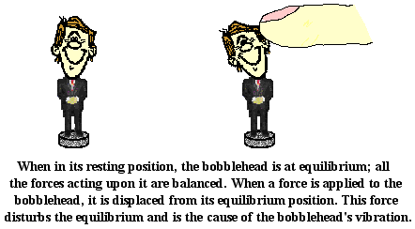
Vibrating system
motion of vibrating system repeats at regular time interval - the period of the vibration
A force constantly acts to restore the system toward its equilibrium position – Restoring Force
Source: The Physics Classroom

Slide 11

Vibrating system
motion of vibrating system repeats at regular time interval - the period of the vibration
A force constantly acts to restore the system toward its equilibrium position – Restoring Force
Source: The Physics Classroom

Slide 12


Vibrating system
Mass-spring system
spring
mass
Understanding Simple Harmonic Motion
Understanding Resonance
Source: The Physics Classroom

Slide 13

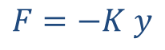
Vibrating system
Simple Harmonic Motion
Periodic motion
Restoring force (F) is proportional to the displacement (y)
Restoring force (F) always acts in a direction to restore mass (m) in equilibrium
$$F=−K y$$
Equilibrium
F = Restoring force (N)
K = spring constant (N/m)
y = displacement (m)

Slide 14
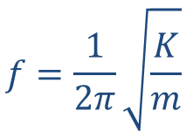
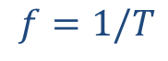
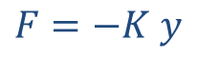
Vibrating system
Simple Harmonic Motion
Restoring Force
Frequency of vibration is number of oscillations per second (in Hz)
Frequency of vibration of a spring mass damper system is given as
$$F=−K y$$
$$f=1/T$$
$$f=\frac{1}{2π}\sqrt{\frac{K}{m}}$$
f = frequency of vibration (Hz)
K = spring constant (N/m)
m = mass (Kg)
Source: The Physics Classroom

Slide 15
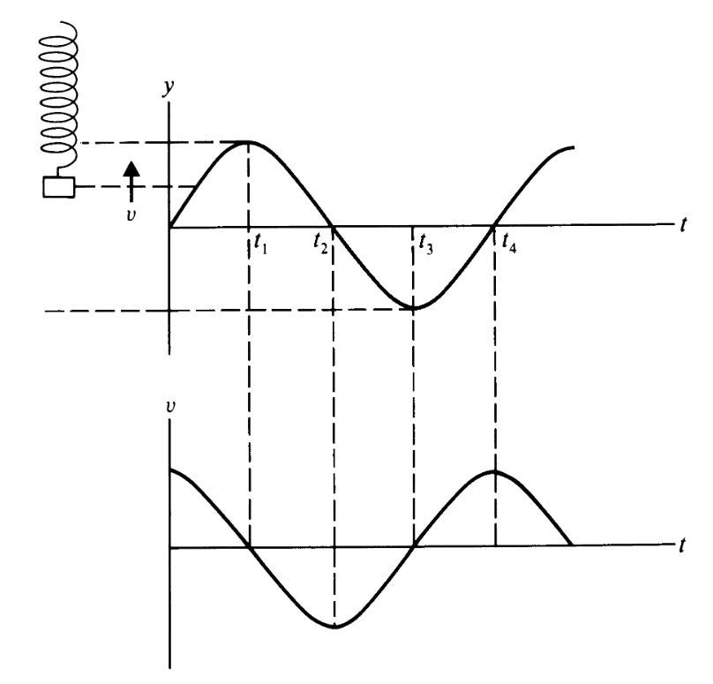
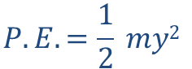
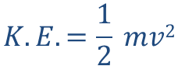
Vibrating system
Energy and Damped Motion
Total Mechanical Energy of the system constantly changing from kinetic to potential to kinetic.
$$P.E.=\frac{1}{2} my2$$
$$K.E.=\frac{1}{2} mv2$$
y = distance from equilibrium (m)
v = speed of moving mass (m/s)
m = mass (Kg)
Notes:
As v goes to maximum y to zero and vice versa

Slide 16
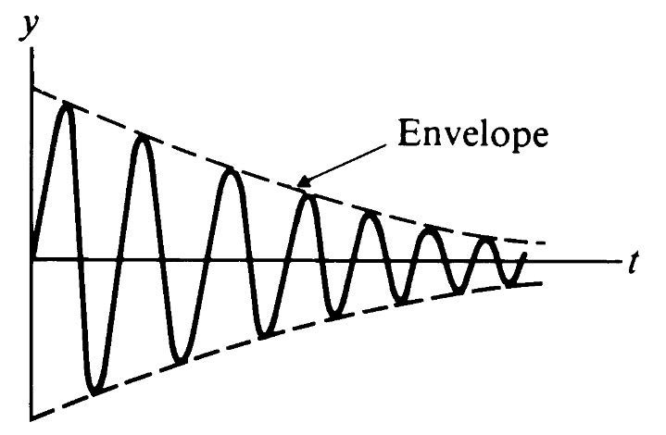
Vibrating system
Energy and Damped Motion
Any real vibrating system tends to lose mechanical energy as a result of friction and other loss mechanisms.
Damping - Tendency of a vibrating object to lose or to dissipate its energy over time.
A vibrating system whose amplitude decreases in this way is said to be damped, and the rate of decrease is the damping constant.
Notes:
Damping as a function of time

Slide 17
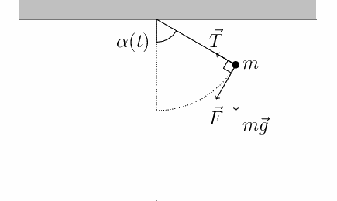
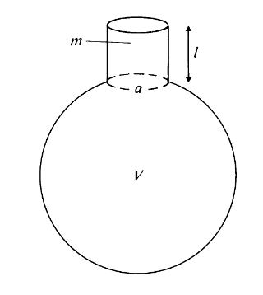
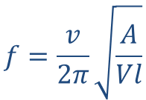
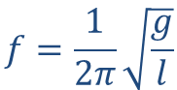
Vibrating system
Some more vibrational systems
Simple pendulum
$$f=\frac{1}{2π}\sqrt{\frac{g}{l}}$$
l = length of string (m)
g = acceleration due to gravity (m/s²)
Helmholtz resonator
$$f=\frac{v}{2π}\sqrt{\frac{A}{Vl}}$$
l = length of neck (m)
A = area of the neck (m²)
V = Volume of the resonator (m³)
v = Speed of sound (approx. 344 m/s)
Notes:
These systems also show simple harmonic montion

Slide 18
Waves

Slide 19
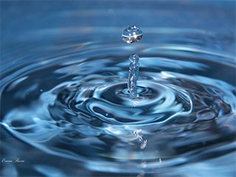
Waves
What is wave?
Disturbance in medium that travels from one position to another position
All waves (light waves, sound waves, surface waves)
Transport energy
Exhibit phenomena :
Reflection
Refraction
Interference
Diffraction

Slide 20
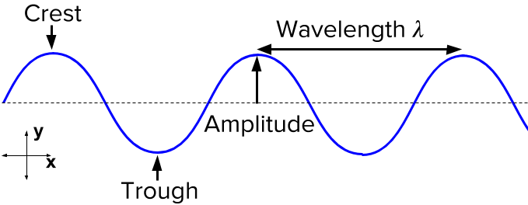
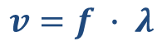
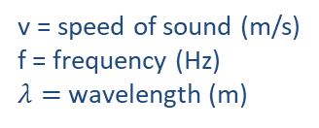
Waves
Wave properties
$$v=f ∙ λ$$
v = speed of sound (m/s)
f = frequency (Hz)
$λ=$wavelength (m)
Source: Khan Academy

Slide 21
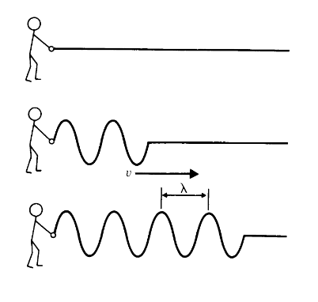
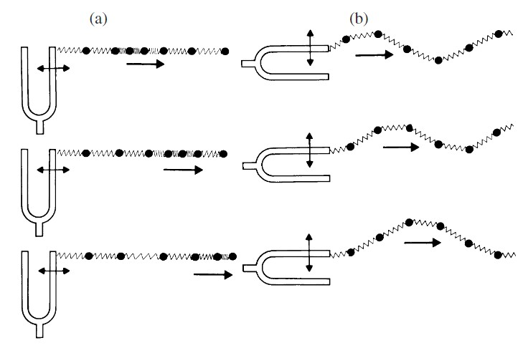
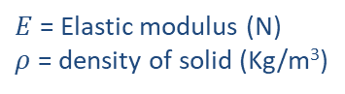
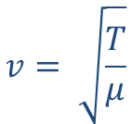
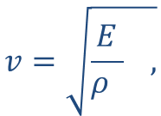
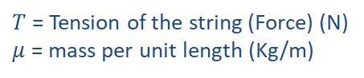
Waves
Progressive wave
Travel continuously in medium in same direction
$$v=\sqrt{\frac{E}{ρ } ,}$$
$E$ = Elastic modulus (N)
$ρ$ = density of solid (Kg/m³)
Longitudinal waves in solid :
Transverse waves on a string:
$$v= \sqrt{\frac{T}{μ}}$$
$T$ = Tension of the string (Force) (N)
$μ$ = mass per unit length (Kg/m)
http://www.animations.physics.unsw.edu.au/
Notes:
Longitudinal and Transverse waves are types of Progressive waves.

Slide 22
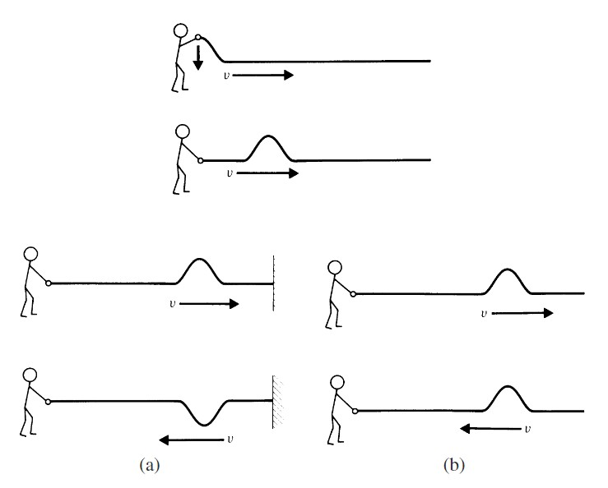
Impulse/ Impulsive wave
Waves
The impulse will travel at the wave speed v and will retain its shape fairly well as it moves down the rope
Fixed end : reversal of phase of reflected wave
Free end : No phase reversal

Slide 23
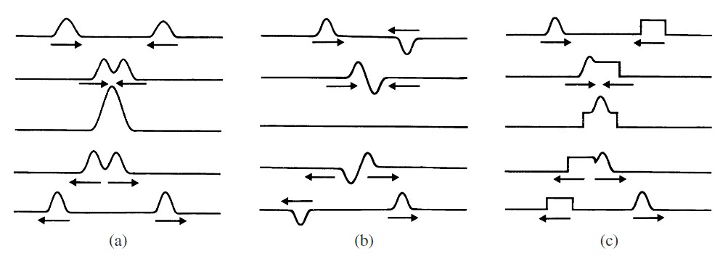
Waves
Superposition and interference
Wave pulses on rope or string obey principle of superposition - the
displacement at any point is the sum of the displacements due to each pulse by itself.
Pulses in same direction
Pulses in different direction
Pulses with different shapes

Slide 24
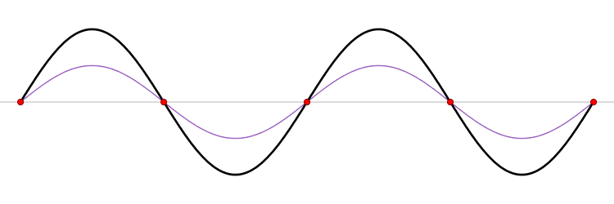
Waves
Standing wave or Stationary Wave
Combination of two waves
Moving in opposite direction
Each wave has same amplitude and frequency
A standing wave (black) depicted as the sum of two propagating waves traveling in opposite directions (red and blue).

Slide 25
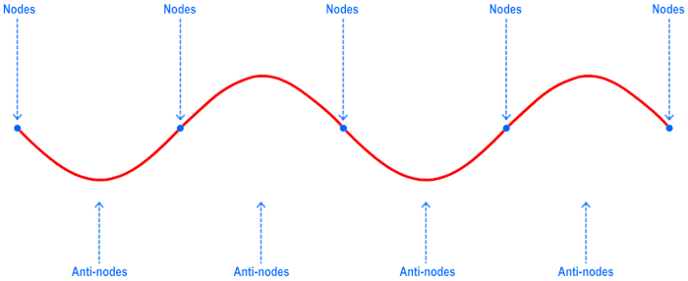
Waves
Standing wave or Stationary Wave
Amplitude displacement minimum - Node
Amplitude displacement maximum - Antinode
Source: ProDuckTheives

Slide 26
Sound Waves
Sound wave
Longitudinal wave
Travels in solid, liquid, gas

Slide 27
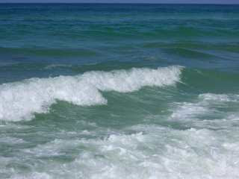
Sound Waves
Wave Propagation in two dimensions
Example: Water waves
Source: Resonance BlogSpot

Slide 28
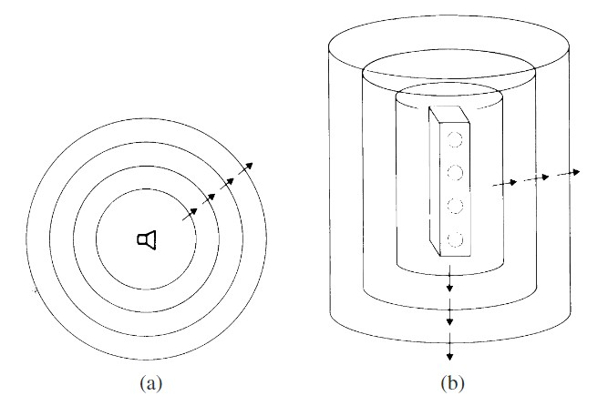
Sound Waves
Wave Propagation in three dimensions
Example: Sound waves or light waves
Single loudspeaker - Point source
Column of loudspeakers - Cylindrical source
Notes:
Different types of sources radiate different kinds of patterns. A point source or a source
that is spherically symmetric radiates spherical waves. A line source or a source with cylindrical
symmetry radiates cylindrical waves. A large flat source radiates plane waves. Real
sound sources are never true point sources, line sources, or flat sources, however; what we
may have in real life are sources that approximate one of these geometries.

Slide 29
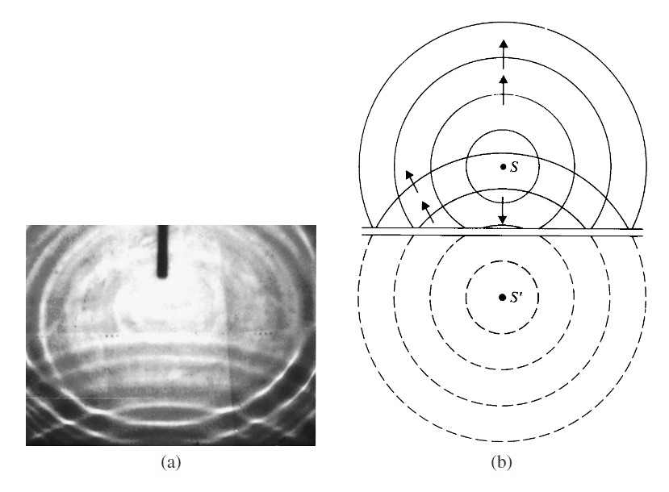
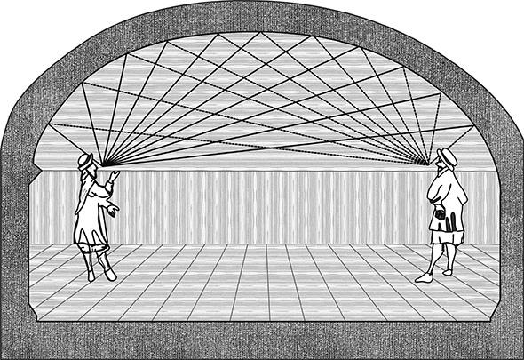
Sound Waves
Reflection
Sound waves reflected back to the source when encountered by a barrier
Principle - Image source
Example : Whisper gallery
Notes:
S prime at the same distance from S, Reflections from a curved barrier

Slide 30
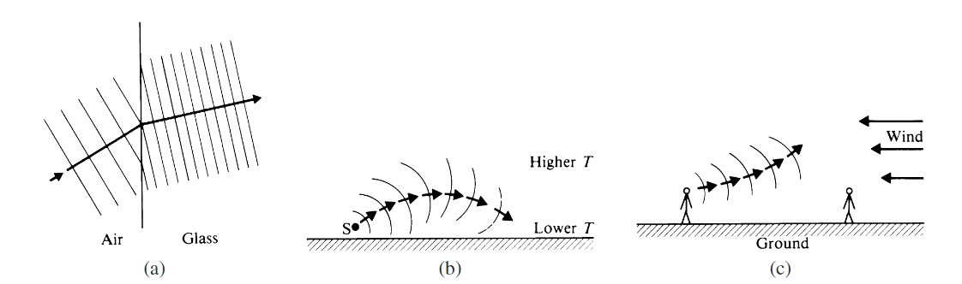
Sound Waves
Refraction
Change in speed of sound
Light wave passes from one medium to another
Sound waves in the atmosphere when
temperature varies with height
Sound traveling against the wind
Notes:
Pg 53

Slide 31
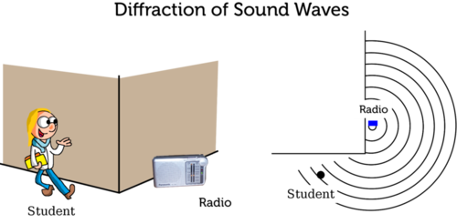
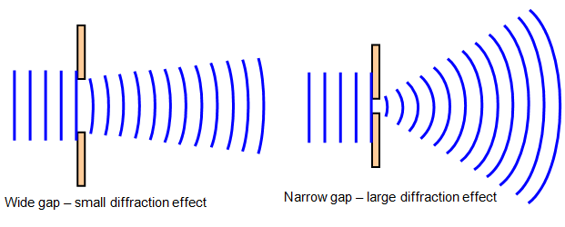
Sound Waves
Diffraction
Bending of waves around the corners of obstacle or through an aperture
Size of the opening in relation to the wavelength that determines the amount of diffraction.
Source: Wave Behaviour Raft

Slide 32
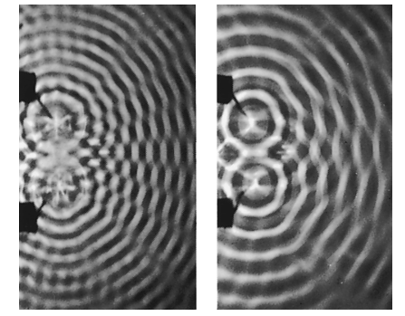
Sound Waves
Interference
Two traveling in the same medium will interfere with each other
Constructive or Destructive Interference
Representation via water wave
https://www.youtube.com/watch?v=D7aftTF--5w

Slide 33


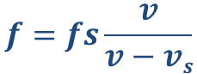


Sound Waves
Doppler effect
Apparent shift in frequency when either the sound source or observer is in motion
Example:
$$f^{′}=fs\frac{v+vo}{v}$$
Apparent frequency when Source at rest, observer in motion:
Apparent frequency when Observer at rest, source in motion:
$$f=fs\frac{v}{v−vs}$$
$fs$ = frequency of the source (Hz)
$v$ = speed of sound
$vo$ = frequency (Hz)
Source: Wikipedia and Charly Whisky

Slide 34
Resonance

Slide 35

Resonance
Resonance
Resonance occurs when one object vibrating at the same natural frequency of a second object forces the second object into vibrational motion.
Example: Breaking a wineglass – Glass breaks when a applied frequency matches natural frequency of wineglass
Source: YouTube

Slide 36

Resonance
Resonance – Mass Spring damper system
When driving frequency, $f= fo,$the natural frequency of the system, resonance occurs
$fo$ = Natural frequency of the mass spring system
$f$ = Frequency of crankshaft
Notes:
Let the crankshaft revolve at a frequency f and let the natural frequency of the mass-spring system be f0. If f is varied slowly, the
amplitude A of the mass is observed to change, reaching its maximum Amax when f = f0. The mass is forced to vibrate at the frequency f of the crank, but when f matches f0, the
natural frequency of the system, resonance occurs. At resonance the maximum transfer of
energy occurs, and the amplitude builds up to a value Amax determined by the friction in
the system. The graph of amplitude A as a function of frequency f , shown in Fig. 4.2,
is nearly symmetrical around its peak, with a width f often called the linewidth. The
linewidth is usually measured at an amplitude of 71% of Amax(Amax/
√
2).

Slide 37

Resonance
Fundamental (1st harmonic)
Standing wave on a String
1st overtone (2nd harmonic)
Resonance also happens in standing waves.
Driving the string at a specific frequency will cause it to “sing”/resonate.
Each frequency has a corresponding mode shape.
2nd overtone (3rd harmonic)
(n-1)th overtone (n-th harmonic)
String: https://www.youtube.com/watch?v=oZ38Y0K8e-Y Plate: https://www.youtube.com/watch?v=wvJAgrUBF4w
Notes:
If a string is driven at the frequency of one of its natural modes, resonance can occur. Driving force can be tuning fork, electromagnet, violin bow

Slide 38


Resonance
Open and Closed Pipes
Resonance also occurs in Pipes
$$fn=n ∙f1$$
Modes of vibration in closed pipes.
Modes of vibration in open pipes.
Source: AllaboutCircuits
Notes:
Modes of vibration or resonances of an open pipe. At the open ends the pressure is equal to atmospheric
pressure. The resulting modes include both odd-numbered and even-numbered harmonics. Minimum displacement occurs at
the nodes denoted by N.
Modes of vibration or resonances of a closed pipe. At the closed end, the air motion is minimum but the
pressure is maximum. The resulting modes include odd-numbered harmonics only. Minimum displacement occurs at the
nodes denoted by N.
N is the node.

Slide 39


Resonance
Resonance – Other examples
Ear Canal
Vocal Tract
Source: ResearchGate - Development of the human auditory system (2012), Bethroars

Slide 40


Resonance
Acoustic Impedance
Defined as the ratio of sound pressure p to volume velocity U
Measured in acoustic ohms.
$$ZA= \frac{p}{U}$$
Acoustic Impedance of wind instruments – determines acoustic response and large influence on sound produced
$p$ = Sound pressure
$U$= Volume velocity

Slide 41
Resonance
Helmholtz Resonator – Applications

Slide 42
Wrap up
Take away message
Fundamentals of Sounds
Sound sources and processes of sound generation
Physical quantities provide information to analysis motion of an object
Vibrating Systems
Simple harmonic motion – Restoring force directly proportion to displacement
Damping - Loss of mechanical energy over time
Waves
Transport energy
Wave behavior encountered in various phenomena
Resonance
Driving frequency of one object equal to natural frequency of second object
Observed in string, pipes

Slide 43
Questions?
Pictures from Google

Slide 44
Thank you!
Pictures from Google

